Slide 1
HIGHWAY VECHICLE ACCIDENT IDENTIFICATION AND AUTO COMMUNICATION TO PATROL & HOSPITAL

Slide 2
ABSTRACT:
In our project deals design a road accident identification with auto SMS system. This is very useful system for high way department. In this system every vehicle is featured with accident sensor and transmitter module. If there is any collision between vehicles, the transmitters send the signal to nearer receiving tower.
In receiving tower, the auto SMS system information about accident to police station, hospital and relief squad. The remote process is done using ISM 433.92 MHz module. The microcontroller is mainly used for the SMS selection. Here we are using Arduino micro controller. The port lines are connected to the GSM MODEM.

Slide 3
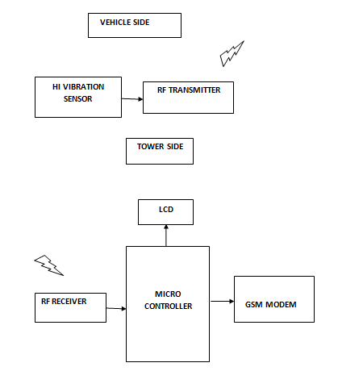
Block Diagram:

Slide 4
Block Diagram Explanation:
In our project RF Encoder will be placed in vehicle section and the RF Decoder ,LCD,GSM Module are connected to the Controller section.
If the button in RF Encoder at Vehicle Section is pressed the alert SMS is send to the respective patrol and nearest hospital for rescue operations.

Slide 5
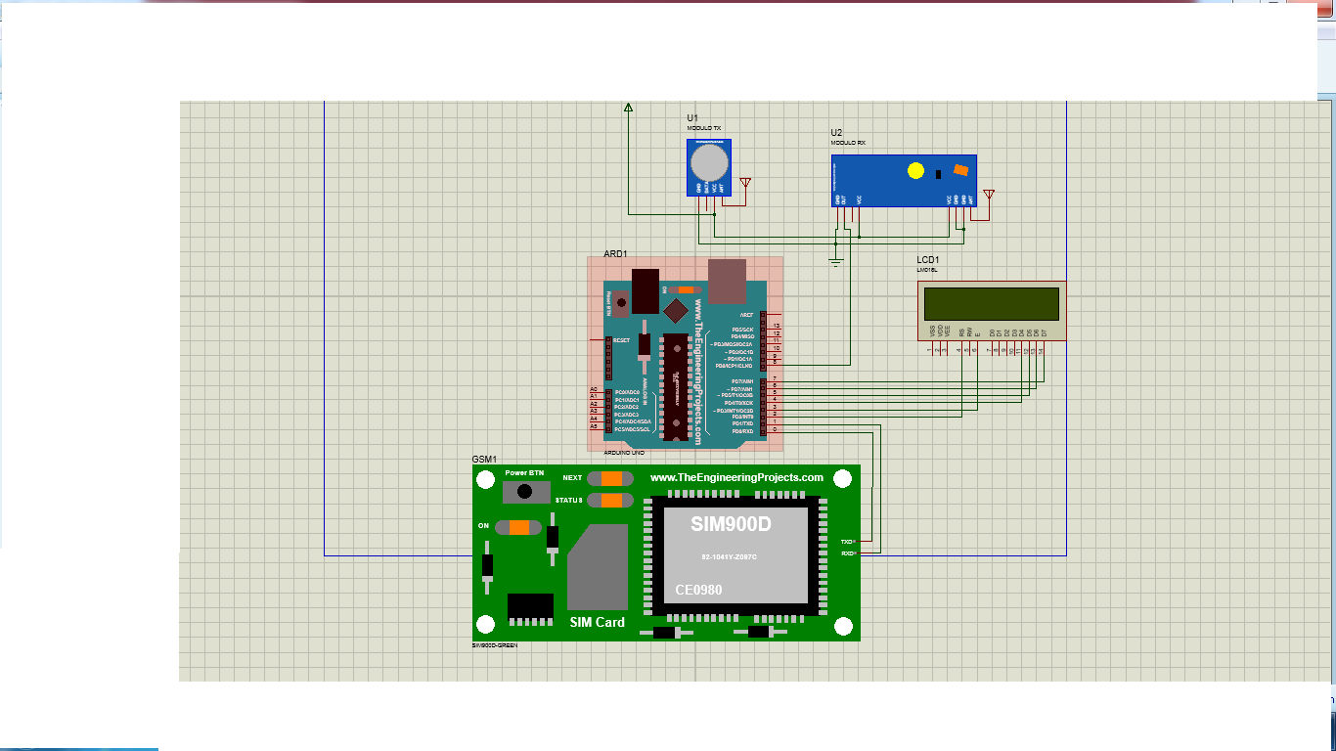
Circuit Diagram:

Slide 6
Circuit Diagram Explanation:
RF encoder will be powered up by using battery and the RF Decoder unit output connected as Digital Input pin of Arduino
The LCD Module connected to Arduino for viewing Emergency Information's
The GSM Modem is connected to the UART port of Arduino,it will be used for sending SMS

Slide 7
Advantages:
Alert will be send automatically
Rescue operations made immediately

Slide 8
Applications:
Rescue systems

